Slide 1
SC EDD (Every Day Drone)
Mavic 3 E 1st setup & settings for SC Edge workflow
13/08/2024

Slide 2
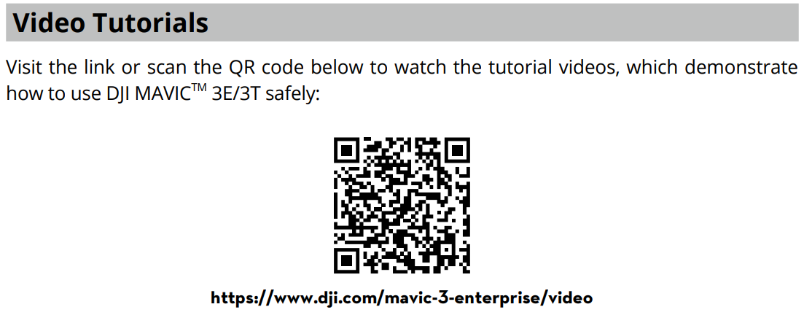
Please read the Edge2 Guide & Mavic 3E manual as well as watch the Mavic 3 E tutorial videos 1st before proceeding.
Mavic 3E Tutorial Videos to watch:
DJI Mavic 3 Enterprise Series｜Intro Video
DJI Mavic 3 Enterprise Series｜First Flight
DJI Mavic 3 Enterprise Series｜Using the RTK Module
DJI Mavic 3 Enterprise Series｜Firmware Update
DJI Mavic 3 Enterprise Series｜RTH Mode
DJI Mavic 3 Enterprise Series｜Obstacle Sensing and Avoidance
DJI Mavic 3 Enterprise Series｜Mapping Mission
DJI Mavic 3 Enterprise Series｜Linear Mission
DJI Mavic 3 Enterprise Series｜Real-Time Terrain Follow
DJI Mavic 3 Enterprise Series｜Pilot 2 App V7.1
D1Store Technical support:
Phone: 1300 090 802
Email: support@d1store.com.au.
Smart Construction support
Phone: 1300 445 978
Email: scsupport@komatsu.com.au

Slide 3
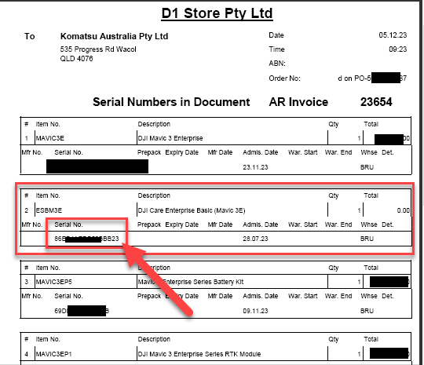
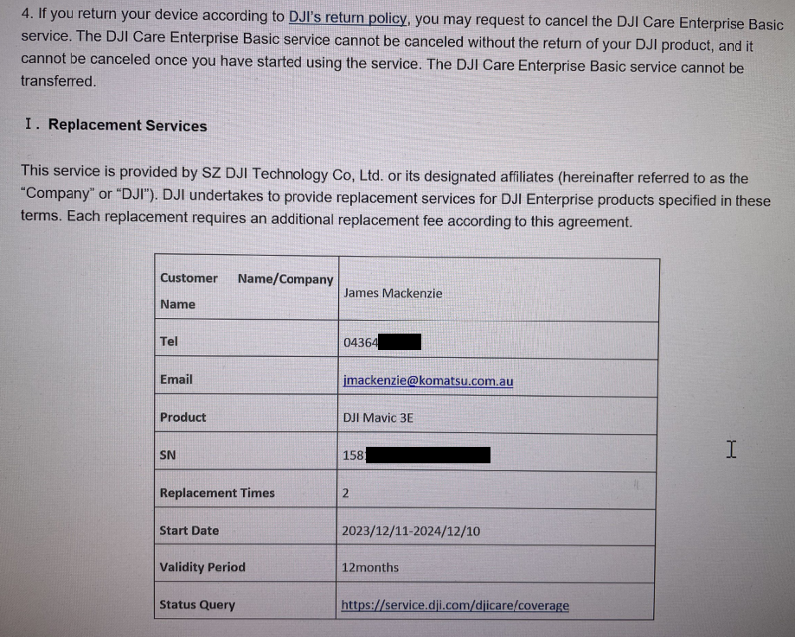
1St Time Mavic 3 E Setup & Care Activation
Register your drone to your Care Basic/Plus to activate the coverage
This must be done within 48Hrs of 1st power on so be ready to activate it when you do this.
Using the controller, Power on & connect Wi-Fi by Sliding your finger from the top screen down twice and select the Wi-Fi (See Slide 6). Log in with your DJI account, if you don’t have one create one and log in.
Select “DJI Care Enterprise”
Select “Service Activation” & input your code. The code (SN# can be found on your invoice under line description DJI Care Enterprise.
If successfully activated, you will receive an email confirmation
3
4

Slide 4
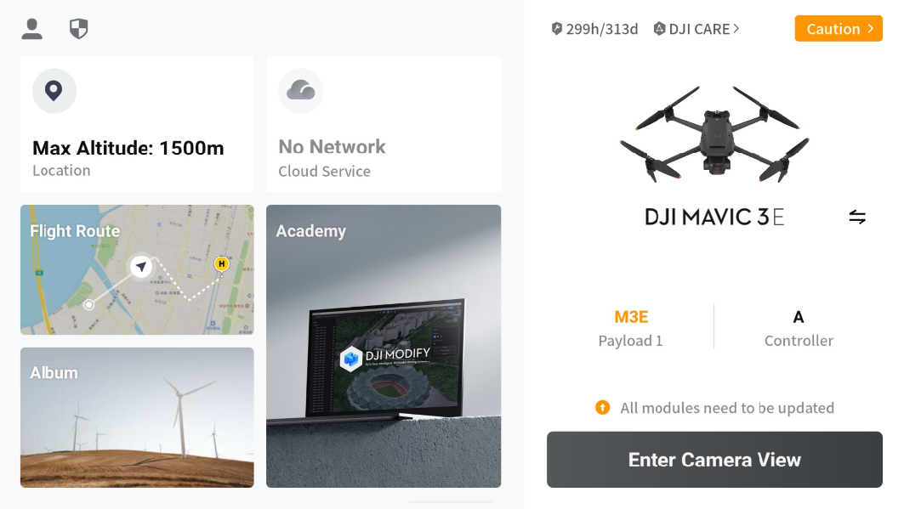
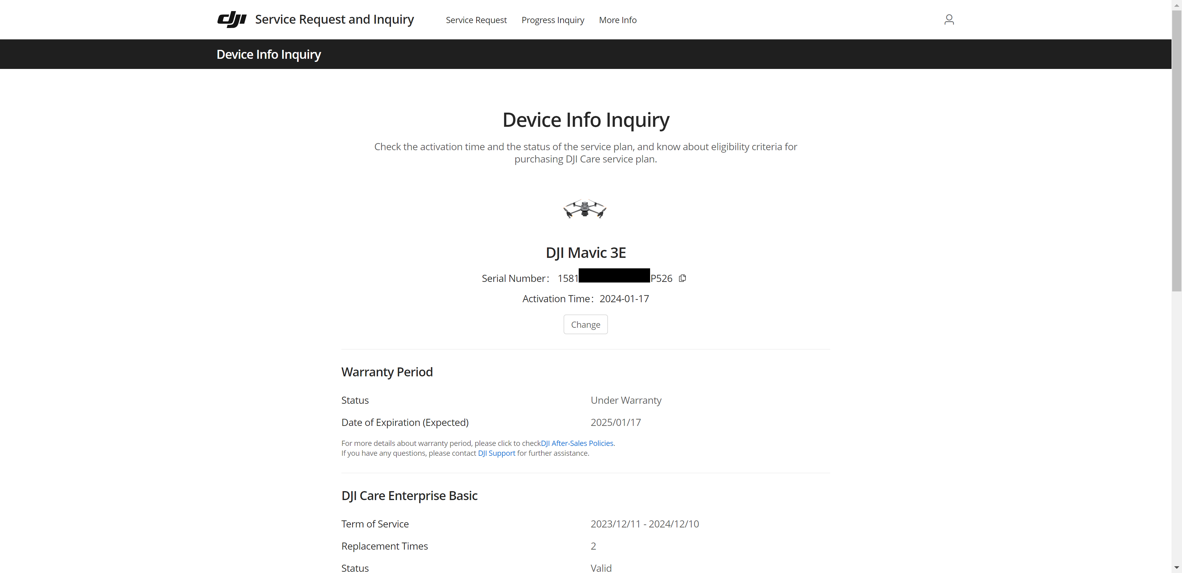
1St Time Mavic 3 E Setup & Care Activation
Check you activation status on the controller or by logging into the official DJI website with your credentials

Slide 5
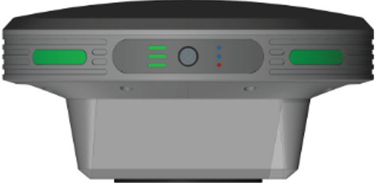
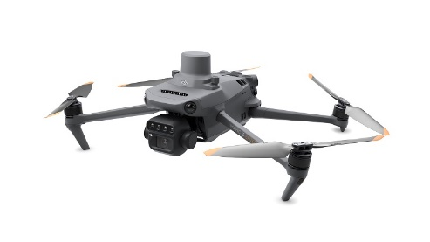

Follow these Steps & Recommended settings
SC Edge - Step
Start Edge PPK Logging (See Edge guide)
Drone (Mavic 3 E) - Steps
Insert a fully charged battery
Insert a clean working SD Card ( Read/Write speed of >90Mb/s)
Connect propellers
Place drone in a clear open space
Power on drone and controller.
Perform Compass Calibration
*Create a Flight Plan & Wi-fi connection & Settings (Step by Step Instructions in the next slides)
*Launch Drone
Land drone
Edge - Step
Process drone data(See Edge guide)
Send processed data via Cloud or Upload via USB to Dashboard (See Edge guide)

Slide 6
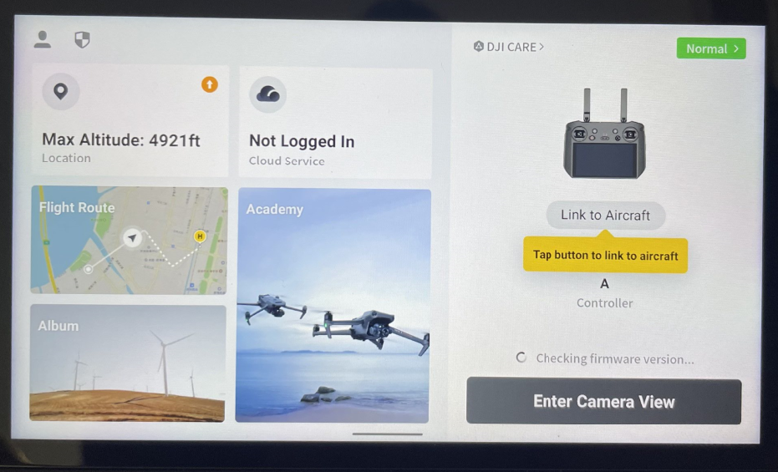
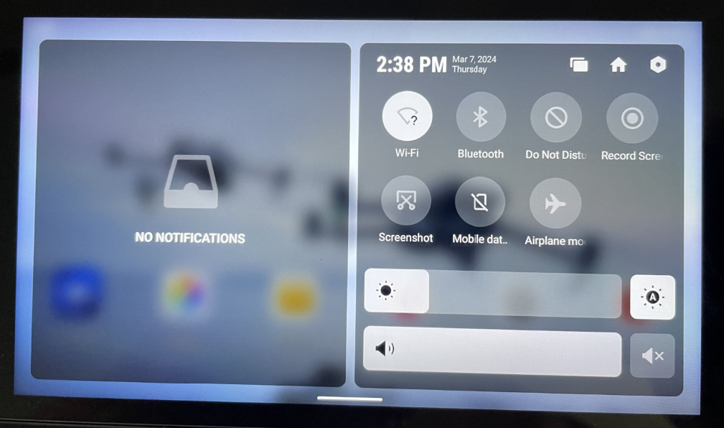
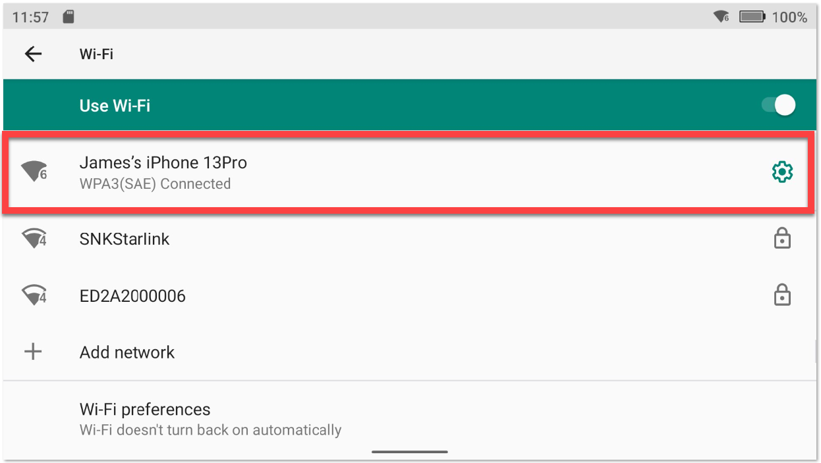
# 7 – Connecting to Wi-fi
After you have successfully setup your new Mavic 3 E and activated your Shield Cover you should proceed to flying your drone
Connect to Wi-Fi by dragging your finger from the top of the screen down.
Press & hold the Wi-fi icon. Select a Wi-Fi connection & input the Wi-Fi password.
*It should say connected.
(Phone Hotspot recommended)
1
Press & Hold
2

Slide 7
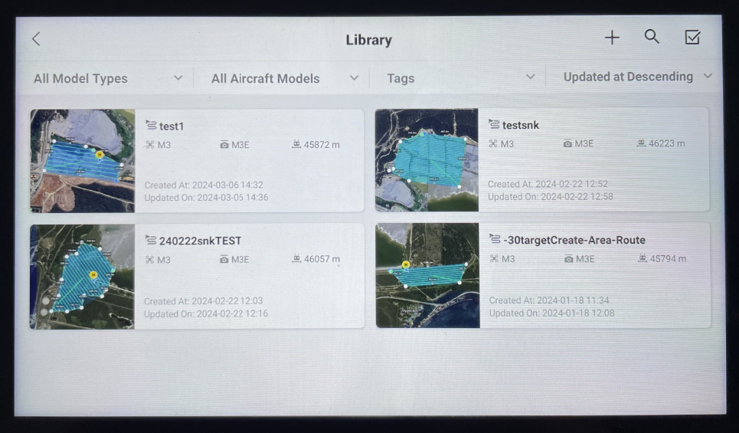
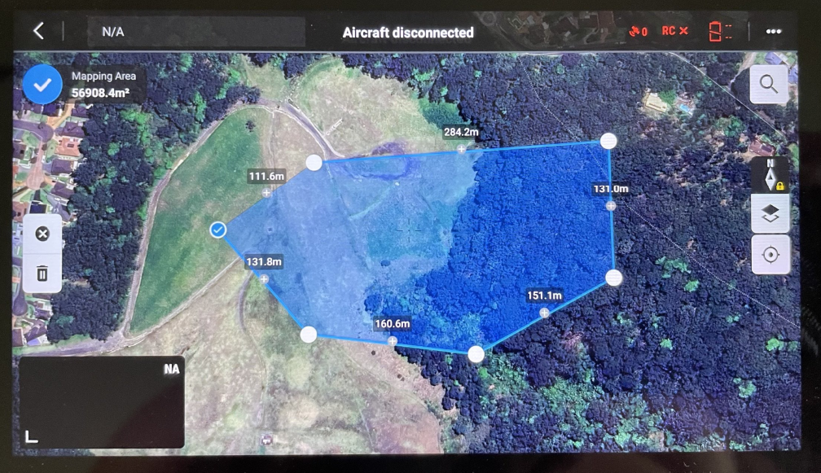
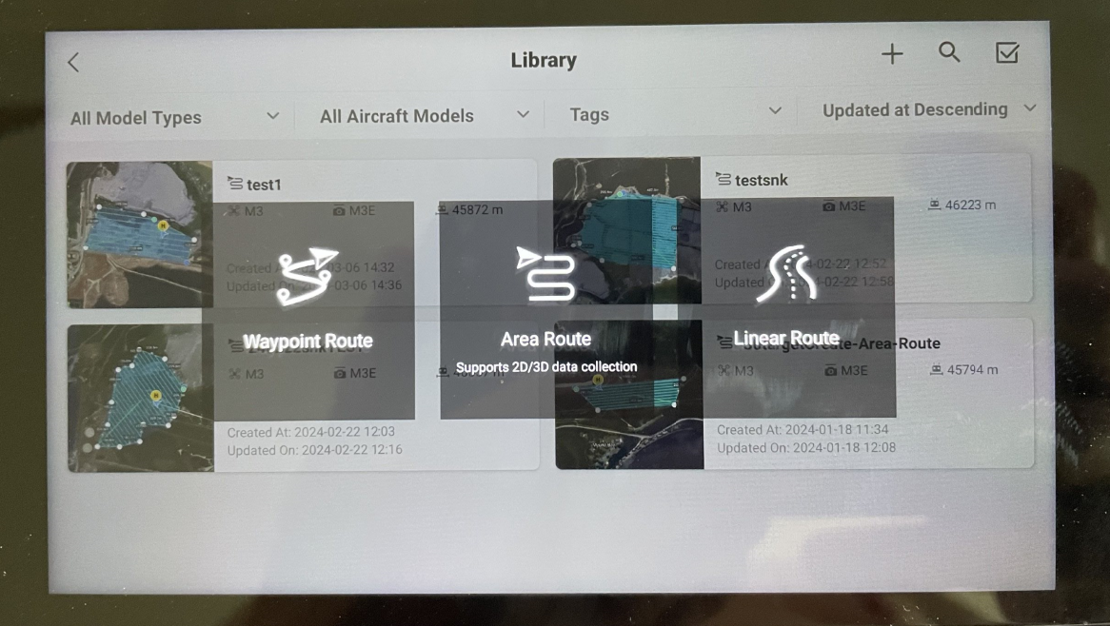
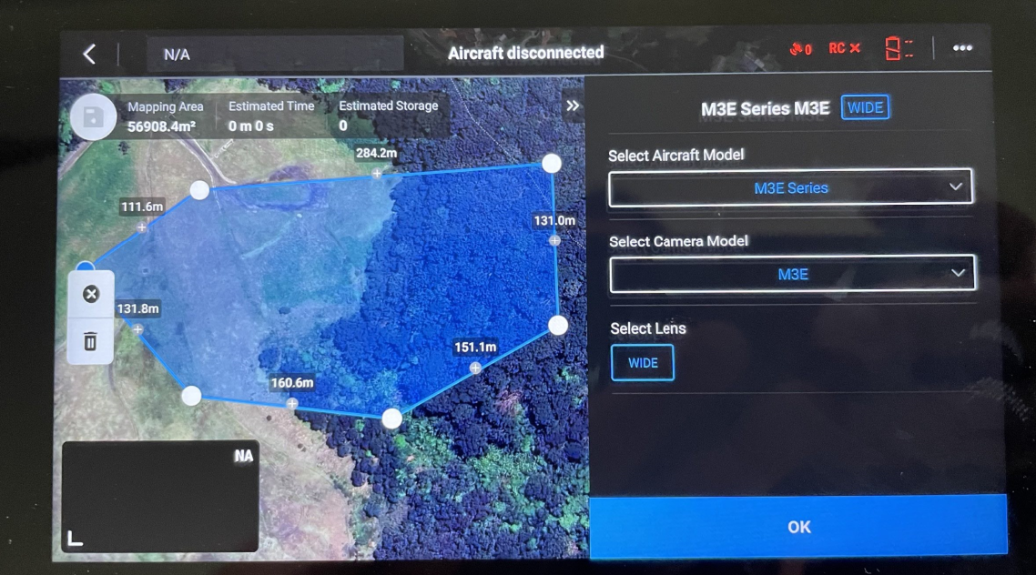
# 7 – Create a Flight Plan using the “DJI Pilot 2”
Steps:
Open the “DJI Pilot 2” App
Access “Flight Route”
Press the plus icon
Select “Area Route (Support 2d/3d data collection)” to create a flight plan
Set Perimeter Waypoints in sequenced order. Press the Tick to complete
Set Aircraft Model as “M3E Series”& Camera Model as “M3E”. Lens “Wide”. Press “OK” - Must
Continued
2
3
4
5
6

Slide 8
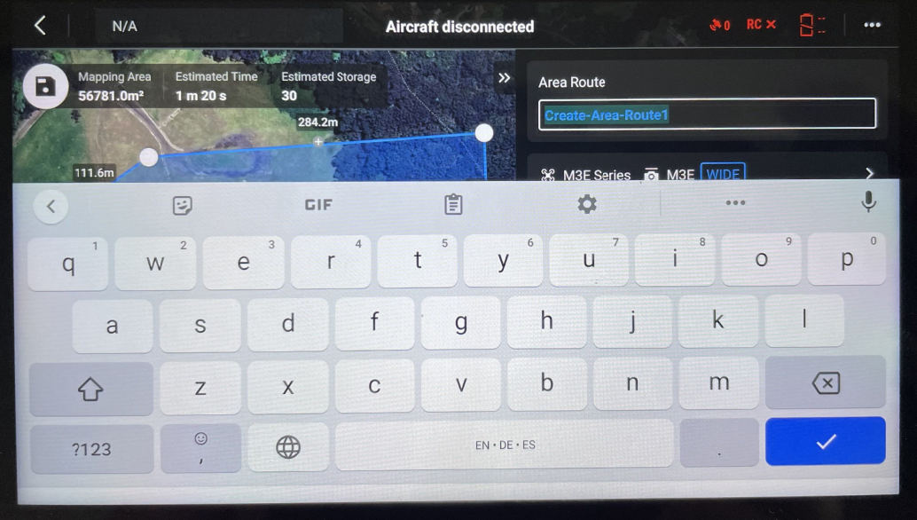
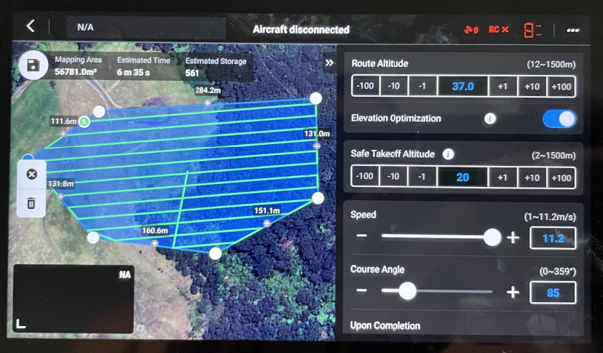
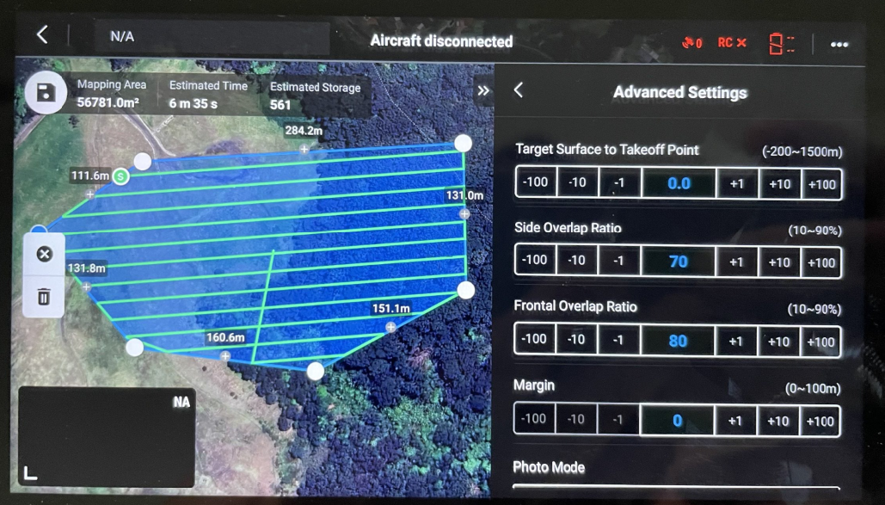
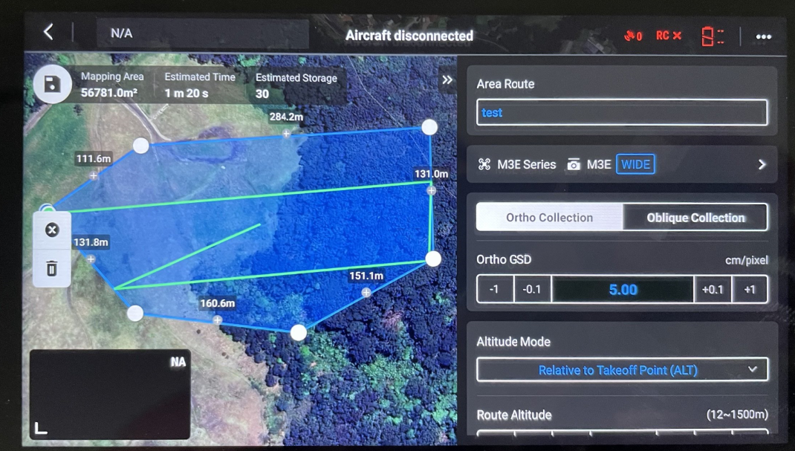
# 7 – Create a Flight Plan using the “DJI Pilot 2” - Continued
Identify any terrain features or obstacles that could affect the safety of the flight, such as trees, buildings, power lines, or other structures for a save “Route Altitude”.
Name your flight
Set desired:
  “Route Altitude’ considering accuracy required & any obstacles that may impact the safety of the flight. 37 Altitude for optimum accuracy 0.99GSD.
  “Elevation Optimisation” On – Must
  “Speed” Max (Consider slower speed with low light)
Ortho Collection - Must
In “Advanced Settings” Side Overlap 60-70 (60 for flat even terrain,) Front Overlap 80 (Always). 70/80 are required for Cloud SfM
To avoid disappointment, use default 70/80 overlap
Continued
7
8
9
10

Slide 9
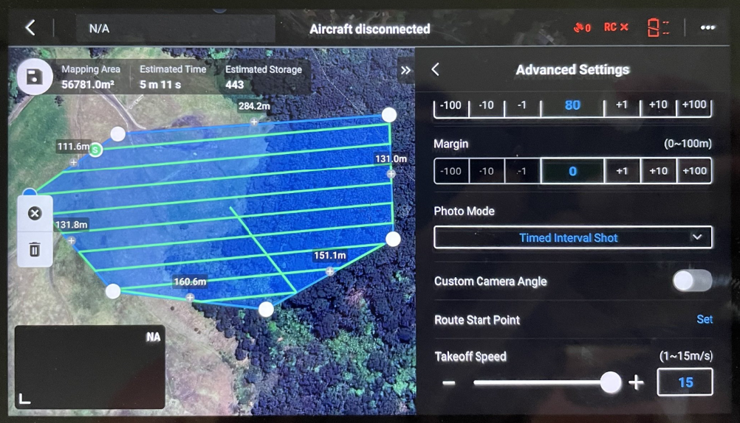
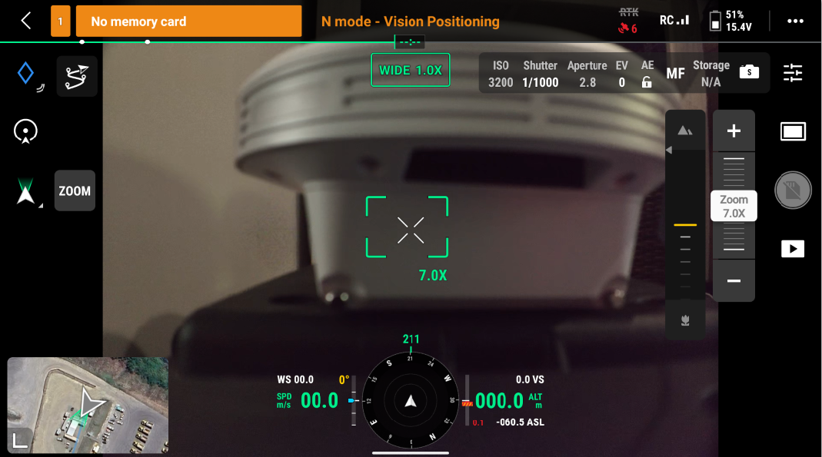
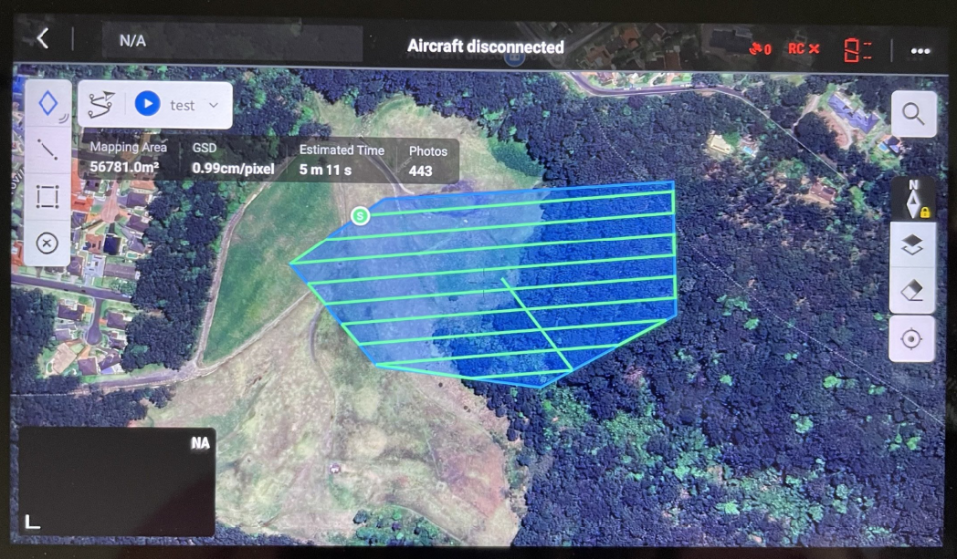
# 7 – Create a Flight Plan using the “DJI Pilot 2” - Continued
Photo Mode “Timed Interval” - Must
After you confirmed all flight parameters are set press the “Save” icon
With the drone on tap the live M3e View (Bottom Left Cnr). This will switch to live camera & settings. Set the following:
  Mode: S “Shutter Priority” - Must
  Auto Exposure - Must
  Shutter Speed: 1/1000(In low Light consider lowering to 500-800 as well as slowing the aircraft speed)
  Focus Mode: MF - Must
  Image Ration: 4:3 - Must
  Image Format: Jpeg - Must
  Lock Gimbal: Enabled - Must
  Mechanical Shutter: Enabled - Must
  Dewarping: Disabled – Must
  Wide 1.0 X – Must
  Tap the Bottom Left Cnr again to switch back
Press “Play” icon to Launch flight mission
12
11
13
14

Slide 10
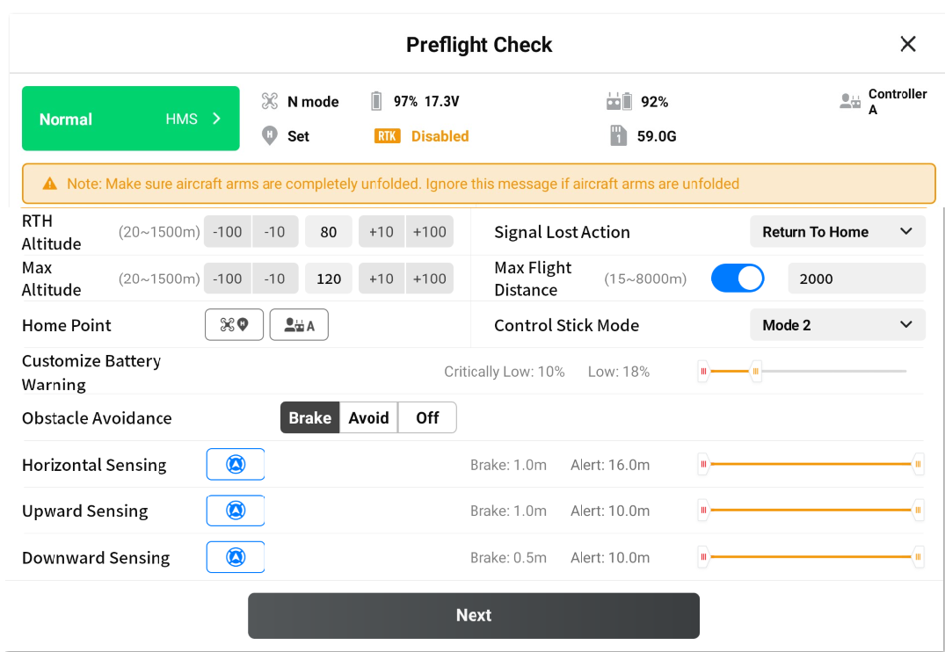
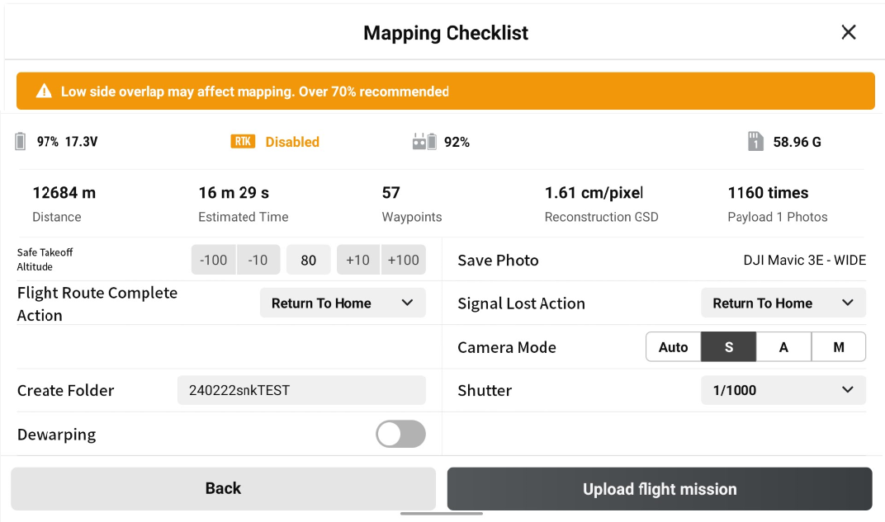
# 8 – Launch the mission
Confirm Pre-Flight Check settings, RTH, Max Flight Distance etc. press “NEXT”
Confirm Mapping Checklist Settings
  “Dewarping” Off –Must
  “Camera Mode” S –Must
  “Shutter” 1/1000 –Must (In low Light consider lowering to 500-800 as well as slowing the aircraft speed)
  “Upload flight mission” Launches the mission & the drone takes off.
1
2

Slide 11
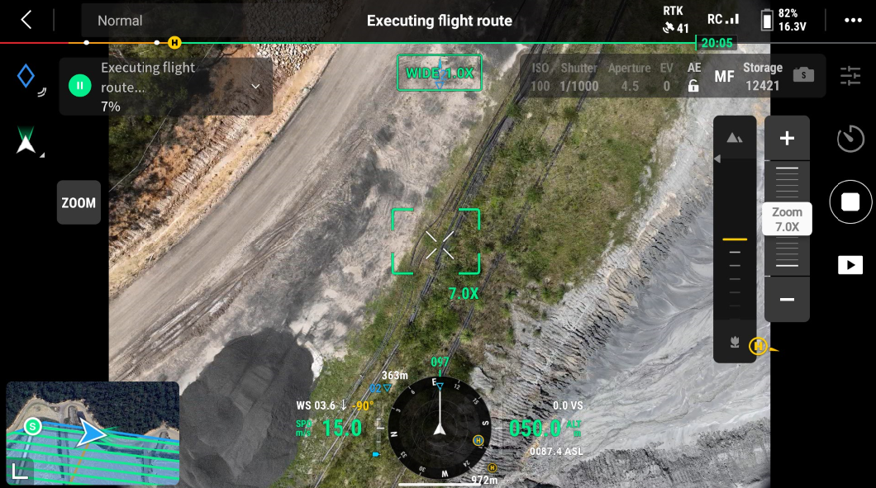
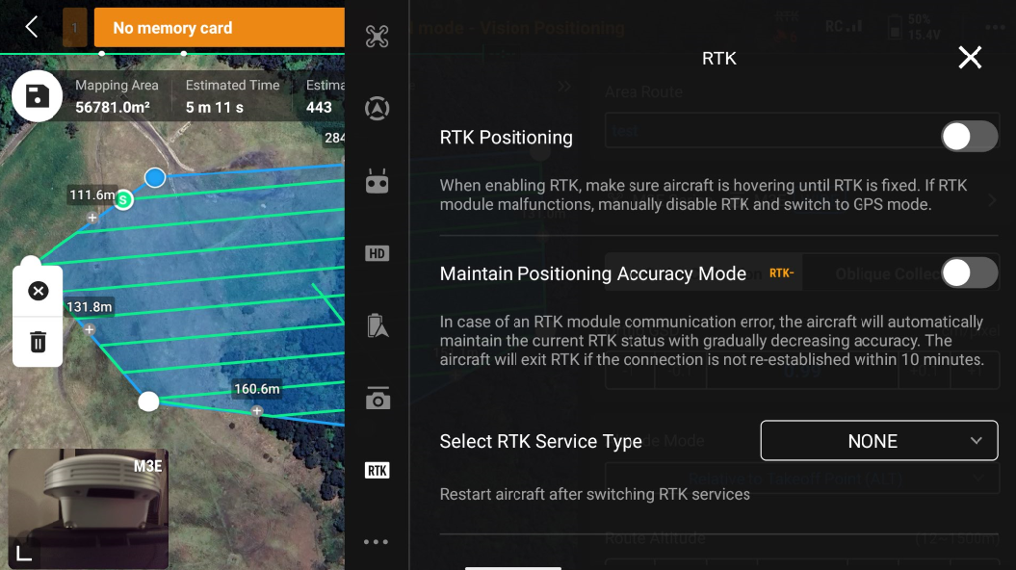
Important information
Be careful not to set Zoom function, this will cause SfM error & can't process the photos. Should always be WIDE 1.0X. Make sure your settings matches & DO NOT CHANGE IT DURING FLIGHT
PPK flight are highly recommended. To conduct a PPK flight don’t turn on RTK mode
(To perform an RTK flight turn RTK On and input your credentials & Mount Point settings.)
1
2
OFF
OFF

Slide 12
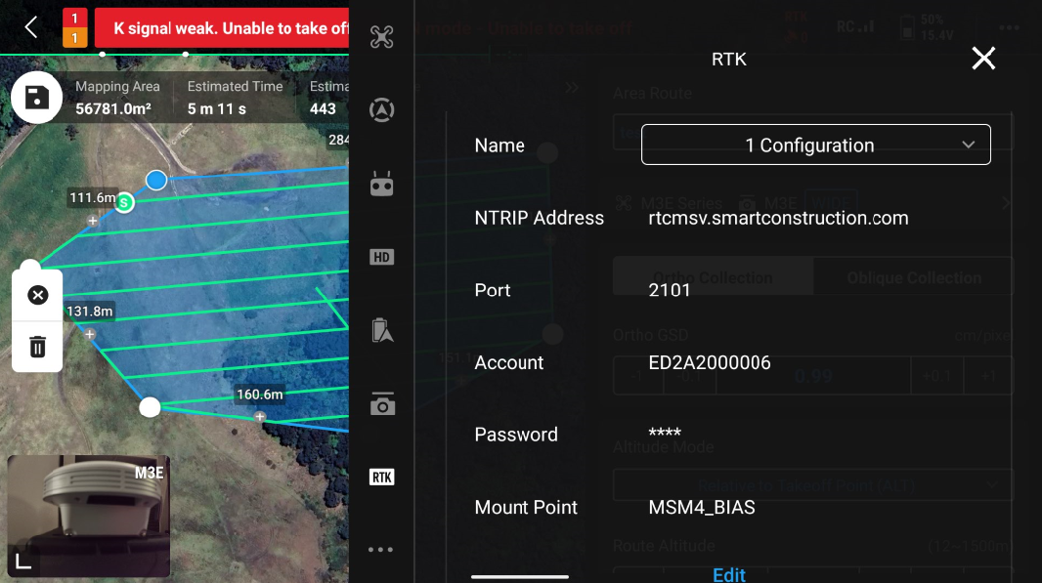
Important information – RTK mode settings
Turn ON “RTK Positioning” & “Maintain Position Accuracy Mode”
Select RTK Service Type “Custom Network RTK”
Input credentials, this varies pending your provider. Please consult with your provider. Example of Edge2
  NTRIP Address:
  Port:
  Account:
  Password:
  Mount Point:
1
ON
ON

Slide 13
SC Edge – Post drone flight & Processing drone data(SfM)
Stop PPK Logging (See SC Edge Guide) 5 min after drone was powered off
Inset SD Card, Import Photos and start processing the drone data (See SC Edge Guide)
See SC Edge Guide on how to import drone data onto SC Dashboard for analytics and visualisation

Slide 14


